Slide 1
NHL Playoff Classification
Jason Carlson

Slide 2

Project Background
Goal: To classify NHL teams as playoff/non-playoff using data from a year earlier
Data on the first round of the NHL draft
Team/aggregated player stats
Sub-Goal: To see what aspects of the game (coach, skaters, goalies, draft) impact playoff potential the most
Model Types: LDA, svmPoly, RandomForest, KSVM (SVC), SVM (SVC) Linear

Slide 3
Data
Variable Name | Variable Description | Variable Type
Last Year Rank | Team ranking in NHL standings last year | Categorical (ordinal)
Last Year Playoff | Whether or not the team made the playoffs last year | Categorical (binary)
Last Year Points | Team points (win/loss, not scoring) last year | Nominal
Last Year GF | Total team goals for last year | Nominal
Last Year GA | Total team goals against last year | Nominal
Last Year PIM | Total team penalty minutes last year | Nominal
Last Year W% | The teams win percentage last year | Nominal
Last Year L% | The teams loss percentage last year | Nominal
EGF (estimated goals for) | Calculated by taking a team roster for the current year and adding up each players goals scored from last year. | Nominal
EPPG (estimated points per game) | Same as EGF, but sum points per game | Nominal
EPIM (estimated penalty minutes) | Same as EGF and EPPG, but sum penalty minutes | Nominal
EGA (estimated goals against) | Same as EGF and EPPG, but sum goals against | Nominal
NumPicks | # First Round Picks for the team that year | Nominal
HighPick | Highest Pick Last Year | Nominal
NewCoach | Whether or not the team got a new coach in the offseason | Categorical (binary)
Playoff | Whether or not a team will make the playoffs. | Categorical (binary) Dependent Variable
Summary: NHL Statistics and Draft Data from 1970-2011
Structure: 4 categorial, 12 nominal
Estimated Varialbles:
Goals For
Points per Game
Penalty Minutes
Goals Against
Sources:
Player Data: Kaggle
Draft Data: NHL.com

Slide 4
The Base Model: Team and Skater Stats
RF | 0 | 1
0 | 46 | 19
1 | 33 | 124
Accuracy: .7658
Last Year Rank
Last Year Playoff
Last Year Points
Last Year GF
Last Year PIM
Last Year W%
Last Year L%
EGF (estimated goals for)
EPPG (estimated points per game)
EPIM (estimated penalty minutes)
Playoff
CV Tree | 0 | 1
0 | 50 | 26
1 | 29 | 117
Accuracy: .7523
CV Tree2 | 0 | 1
0 | 51 | 28
1 | 28 | 115
Accuracy: .7477

Slide 5
The Second Model: Add Goalie
CV Tree | 0 | 1
0 | 50 | 26
1 | 29 | 117
Accuracy: .7523
KSVM | 0 | 1
0 | 61 | 14
1 | 18 | 129
Accuracy: .8559
Last Year Rank
Last Year Playoff
Last Year Points
Last Year GF
Last Year GA
Last Year PIM
Last Year W%
Last Year L%
EGF (estimated goals for)
NumGoalies
EGA (estimated goals against)
EPIM (estimated penalty minutes)
EPPG (estimated points per game)
Playoff
RF | 0 | 1
0 | 46 | 19
1 | 33 | 124
Accuracy: .7658
LDA | 0 | 1
0 | 57 | 16
1 | 22 | 127
Accuracy: .8288
CV Tree2 | 0 | 1
0 | 51 | 28
1 | 28 | 115
Accuracy: .7477
SVM Linear | 0 | 1
0 | 63 | 14
1 | 16 | 129
Accuracy: .7523

Slide 6
The Third Model: Add Coach
KSVM | 0 | 1
0 | 61 | 14
1 | 18 | 129
Accuracy: .8559
Last Year Rank
Last Year Playoff
Last Year Points
Last Year GF
Last Year GA
Last Year PIM
Last Year W%
Last Year L%
EGF (estimated goals for)
EPPG (estimated points per game)
EPIM (estimated penalty minutes)
EGA (estimated goals against)
New Coach
Playoff
CV Tree2 | 0 | 1
0 | 61 | 17
1 | 18 | 126
Accuracy: .8423
LDA | 0 | 1
0 | 58 | 15
1 | 21 | 128
Accuracy: .8378

Slide 7
The Fourth Model: Add Draft
SVM Linear | 0 | 1
0 | 64 | 13
1 | 14 | 130
Accuracy: .8739
Last Year Rank
Last Year Playoff
Last Year Points
Last Year GF
Last Year GA
Last Year PIM
Last Year W%
Last Year L%
EGF (estimated goals for)
EPPG (estimated points per game)
EPIM (estimated penalty minutes)
EGA (estimated goals against)
NewCoach
NumPicks
HighPick
Playoff
KSVM | 0 | 1
0 | 63 | 14
1 | 16 | 129
Accuracy: .8649
LDA | 0 | 1
0 | 59 | 13
1 | 20 | 130
Accuracy: .8514

Slide 8
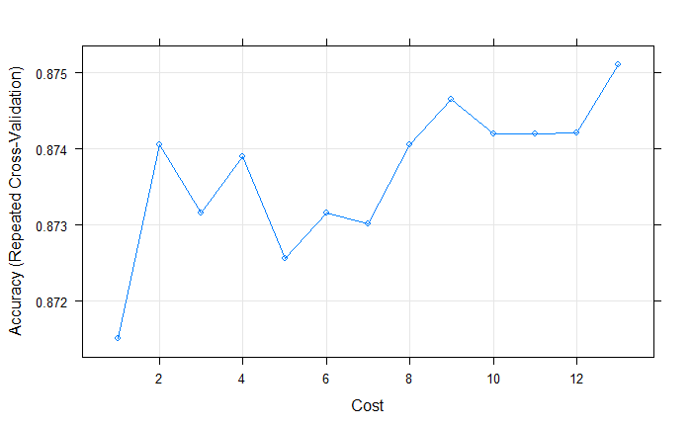
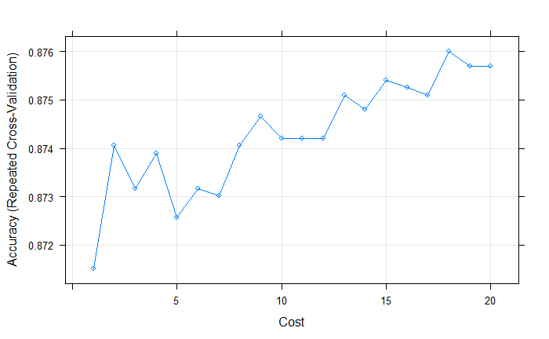
Best Model: SVM Linear
The final value used for the model was C = 13
The final value used for the model was C = 18

Slide 9
Possible Improvements
Figure out a better way to incorporate the draft
More rounds
Player positions
Player college rankings
Incorporate free agency more effectively
Auto detect rebuild state (change captain + change coach + loss of long time vet, etc = rebuild)
More player/team states:
Average age of team
Last playoff/SC win

